Slide 1
Bank Loan Case Study
Veena Chandra

Slide 2

PROJECT DESCRIPTION
The main aim of this project is to identify patterns that indicate if a customer will have difficulty paying their instalments. Our project's primary goal is to enhance the efficiency and accuracy of the bank loan application and approval process.. This information can be used to make decisions such as denying the loan, reducing the amount of loan, or lending at a higher interest rate to risky applicants. The company wants to understand the key factors behind loan default so it can make better decisions about loan approval.By analyzing relevant features such as credit scores, income, and employment history, this will classify applicants as 'creditworthy' or 'non-creditworthy.' This project aims to improve loan approval processes and reduce the risk of bad loans for the bank

Slide 3
APPROACH
In this bank loan case study, my approach began with analyzing three datasets: application.csv. To achieve this, we began by thoroughly understanding the critical steps involved in the process, starting from loan application submission to the final decision of approval or rejection. I then conducted exploratory data analysis (EDA) to understand the data distribution and relationships. During data preprocessing, I addressed missing values and eliminated irrelevant columns to ensure data quality. Additionally, I identified outliers to assess their impact on the model. Moving forward, I performed univariate and bivariate analysis using pivot tables, which allowed me to gain valuable insights into the dataset.
To better understand the interdependencies between variables, I calculated correlations, enabling me to select the most relevant features for the model. This step was crucial in determining the predictive power of the variables in relation to loan default. By considering correlations, I was able to create a more accurate and robust model that could effectively predict creditworthiness and improve the loan approval process.
Throughout the process, I ensured transparency and collaborated with domain experts to validate the results. My approach prioritized data-driven decision-making and adherence to ethical standards, ensuring a successful outcome for the bank loan case study.

Slide 4
TECH STACK USED
Microsoft Excel 2016 - It is a powerful tool for data manipulation, analysis, and visualization.
Microsoft PowerPoint - presentation software used to create engaging and visually appealing slide decks for various purposes.

Slide 5
INSIGHTS
The bank loan case study provides valuable insights into credit risk assessment, key risk indicators for loan default, and customer segmentation. It helps refine loan approval guidelines, select the best predictive model, and improve data quality. Addressing bias ensures ethical decision-making, and analyzing economic factors aids in planning for uncertainties. Overall, the study enables the bank to make data-driven decisions, optimize loan processing, and enhance customer satisfaction.

Slide 6
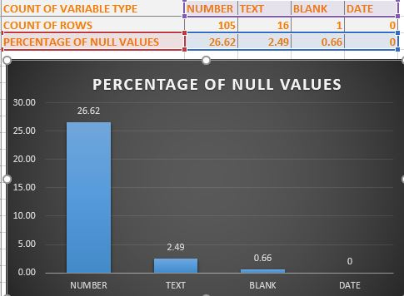
A. Identify Missing Data and Deal with it Appropriately: As a data analyst, you come across missing data in the loan application dataset. It is essential to handle missing data effectively to ensure the accuracy of the analysis. Task: Identify the missing data in the dataset and decide on an appropriate method to deal with it using Excel built-in functions and features.
I applied various functions like COUNTA, COUNTBLANK Functions to find missing values , I dropped out columns which contains more than 30% of null values . And also I deleted some columns which is not relevant to this analysis like weekday_appr_process_start I was having 122 columns and after performing cleaning process I have 64 columns left.

Slide 7
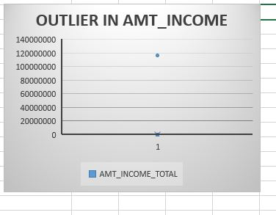
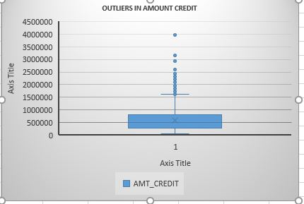
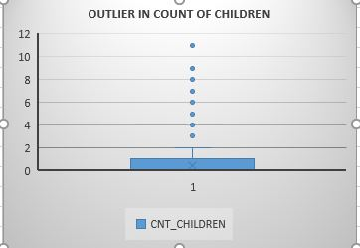
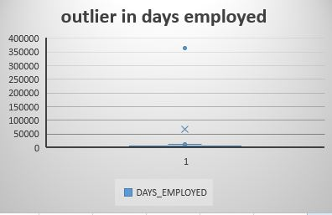
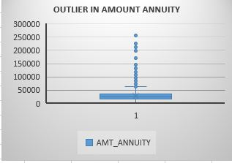
B. Identify Outliers in the Dataset: Outliers can significantly impact the analysis and distort the results. You need to identify outliers in the loan application dataset. Task: Detect and identify outliers in the dataset using Excel statistical functions and features, focusing on numerical variables.

Slide 8
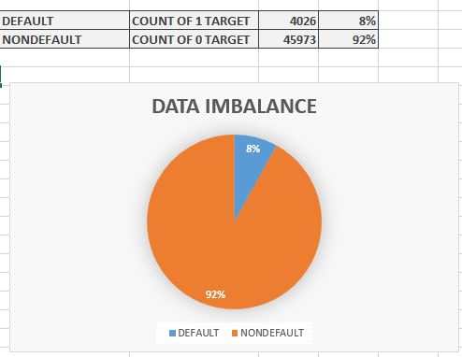
C. Analyze Data Imbalance: Data imbalance can affect the accuracy of the analysis, especially for binary classification problems. Understanding the data distribution is crucial for building reliable models. Task: Determine if there is data imbalance in the loan application dataset and calculate the ratio of data imbalance using Excel functions.

Slide 9
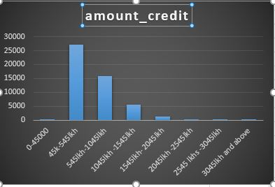
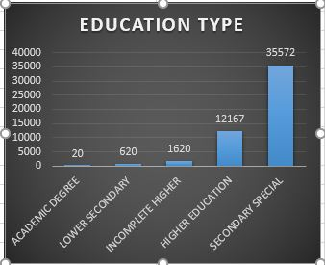
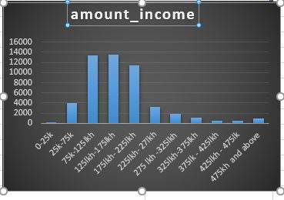
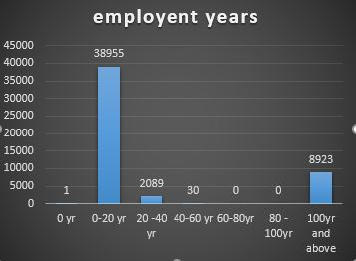
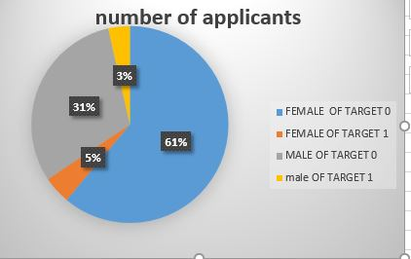
D. Perform Univariate, Segmented Univariate, and Bivariate Analysis: To gain insights into the driving factors of loan default, it is important to conduct various analyses on consumer and loan attributes. Task: Perform univariate analysis to understand the distribution of individual variables, segmented univariate analysis to compare variable distributions for different scenarios, and bivariate analysis to explore relationships between variables and the target variable using Excel functions and features.
UNIVARIATE AND SEGMENTED UNIVARIATE ANALYSIS

Slide 10
INSIGHTS GAINED
we can say that individuals having earnings between 25k to 3 lkhs are high in applying for loans.
we can say that mostly 40 lkh to 1045000 lkh loan amount is credited to customers.
Individuals having education up to secondary are most likely to apply for loans.
people who have been employed about 20 yrs are most high in applying for loan.
Female are most high in application for loan compare to man.
Men has more defaluter ratio compare to women

Slide 11
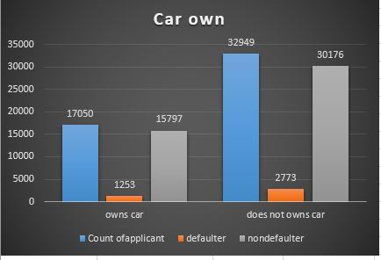
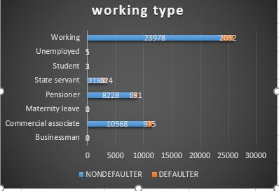
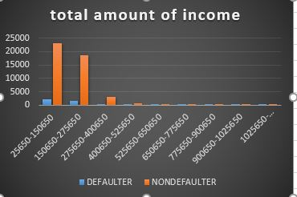
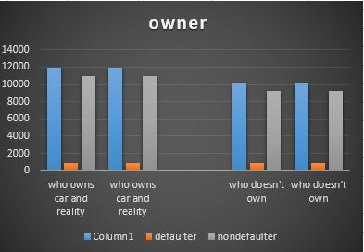
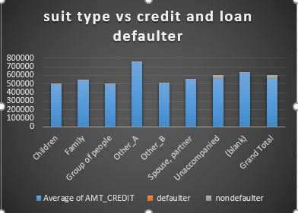
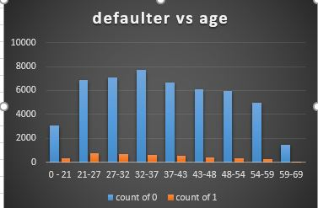
BIVARIATE ANALYSIS

Slide 12
INSIGHTS GAINED
we can see that customers who does not owns car is less likely to have defaulter.
Young peoples age 25 to 35 are more likely to be default.
Individuals with less income are high in default.
Student and Businessmen are less in numbers in default.Thus we can provide loan safely.

Slide 13
RESULT
Through the Bank Loan Case Study, I learned how to assess risk like some customers who don't have a sufficient credit history take advantage of this and default on their loans.hence I used Exploratory Data Analysis (EDA) to analyze patterns in the data and ensure that capable applicants are not rejected.and predict loan defaults. By analyzing data and building models, I gained insights into important risk indicators and customer groups. I also discovered potential biases and considered external economic factors. This project improved my ability to make data-driven decisions, optimize loan processes, and promote responsible lending in the banking industry.

Slide 14
E. Identify Top Correlations for Different Scenarios: Understanding the correlation between variables and the target variable can provide insights into strong indicators of loan default. Task: Segment the dataset based on different scenarios (e.g., clients with payment difficulties and all other cases) and identify the top correlations for each segmented data using Excel functions.
TOP TEN CORRELATION
TARGET
CNT_CHILDREN
AMT_INCOME_TOTAL
AMT_CREDIT
AMT_ANNUITY
AMT_GOODS_PRICE
REGION_POPULATION_RELATIVE
DAYS_BIRTH
DAYS_EMPLOYED
DAYS_REGISTRATION

Slide 15
THANKS
HERE IS THE LINK PROVIDED
PDF LINK-https://docs.google.com/presentation/d/1Gkmv51PxvHmNXz3cjULQWHDvx1EfBezY/edit?usp=drive_link&ouid=102798538525957876779&rtpof=true&sd=true
Bank Loan Case Study PPT.pptx
EXCEL FILE-https://docs.google.com/spreadsheets/d/1YFXEttSJAMAk223s_lyWWR1gIZ_VHkpW/edit?usp=drive_link&ouid=102798538525957876779&rtpof=true&sd=true
LOOM VIDEO LINK-https://www.loom.com/share/5aeda148ed134d5593918d24d0c8a22c?sid=f719dee6-3bc3-45d9-b3b6-7dcc3e3c44a8

